Slide 1
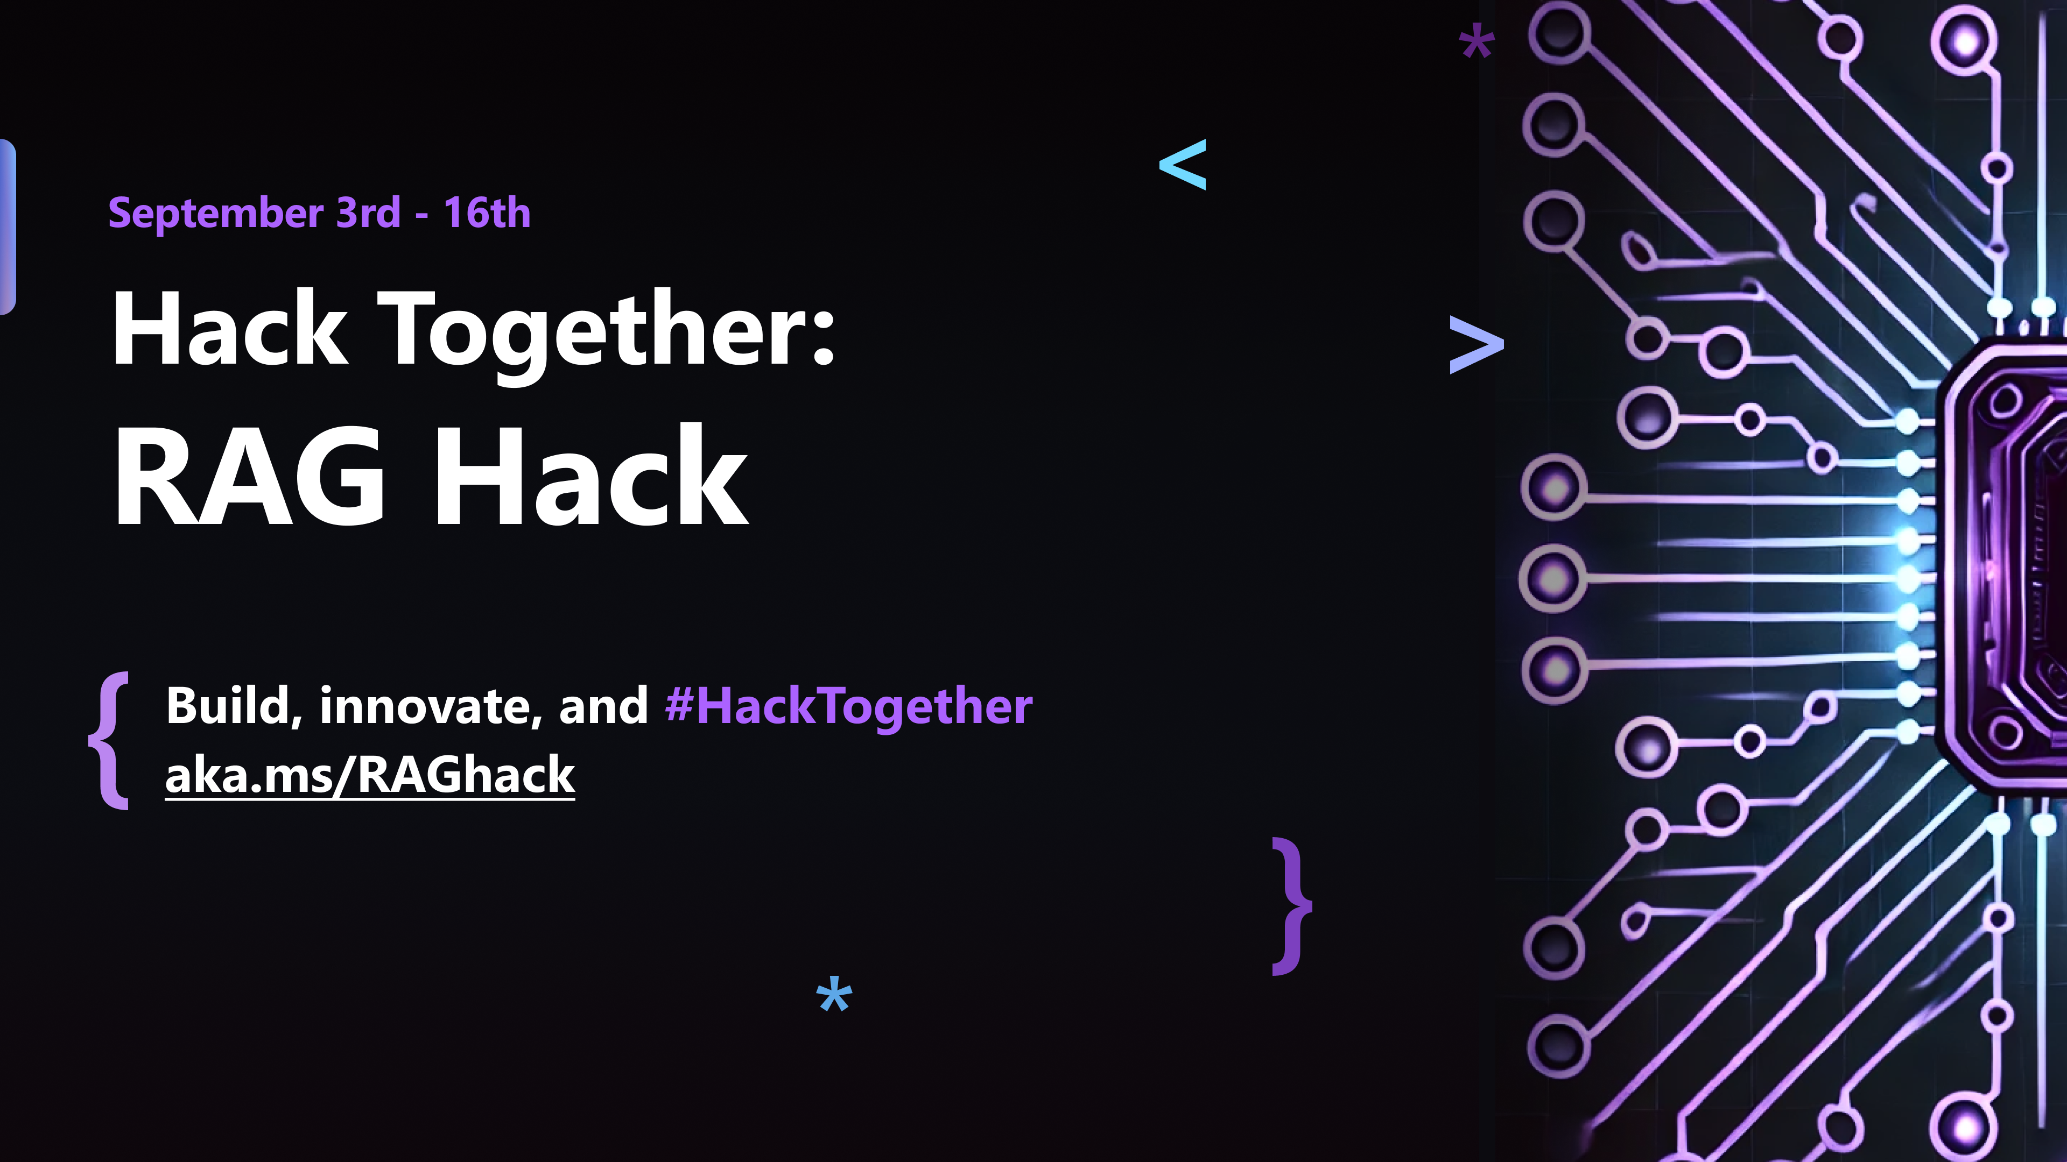
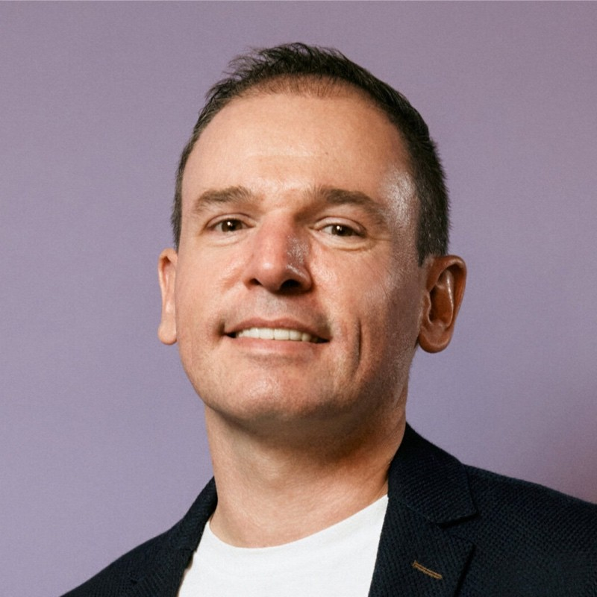
Better RAG with RAFT
Cedric Vidal
Principal AI Advocate
Microsoft

Slide 2
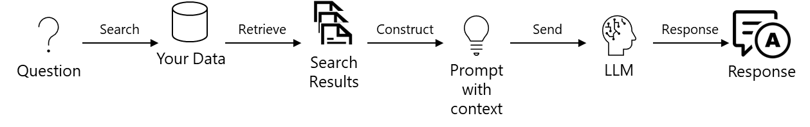
Anatomy of RAG
Augment
Retrieve
Generate
Notes:
This has unlocked a lot of query your own data use cases, e-shopping, e-learning, search engines, …
Limitations
precision and recall issues.
Throughput (input 10x faster than output)
RAG lacks precision in the sense that it can retrieve documents which are irrelevant to the query.
RAG can lack recall when the embedding used is not sufficiently domain specific and will fail to return relevant documents, therefore lacking context for the answer

Slide 3
What is fine tuning?
Fine-tuning refers to customizing a pre-trained LLM with additional training on a specific task or new dataset for enhanced performance and accuracy
LLM
Fine-Tuned LLM
Curated Data Set
Notes:
To overcome these we can use Finetuning.
Fine tuning is a technique to customize a model with your own data – you re-train an off the shelf model (Llama 2 7b etc.) with your own data, and adjust the model weights to improve performance at a specific task. Essentially, it's just a great LLM + your data = great LLM for your use case.

Slide 4
Differentiation
Why fine tune?
Better performance
Developers hope that by fine tuning models with their own data and instructions, they'll get better results for their tasks
Cheaper or faster models
You may want to fine tune a smaller model for a specific task, instead of using an expensive general-purpose model
Most people won’t train a foundation model; fine tuning with proprietary data provides a competitive advantage
Notes:
Why should you fine tune? First and foremost – better performance – think of it as fine tuning = better models. And it's true! With a good, high quality data set, and a good use case, you can create a better model. The flip side is that bad data, or an unsuitable use case, may result in a worse model. Second –fine tuning can save you money. You could fine tune a smaller model, like llama2-7b, to use in place of a more expensive model like Llama3-70-B. You can also use fine tuning to shorten prompts – ultimately reducing your token costs. The best reason to fine tune, though, is differentiation. Your custom model belongs to you – YOUR data, YOUR use case, and YOUR expertise are used to create something unique. That’s a competitive moat!

Slide 5

Challenges of fine tuning
Data
Computational horsepower
Expertise
Notes:
You need a high-quality dataset with a LOT of data for fine tuning. That’s not easy to create.
Training these massive models requires serious computational horsepower. For smaller teams or those on a budget, the costs can quickly become prohibitive.
Developing and maintaining cutting-edge AI isn't for the faint of heart. You need specialized skills and knowledge that can be hard to come by.

Slide 6
Fine-tuning
Recap of current domain adaptation technics
FSL
RAG
Few Shot learning
Retrieval Augmented Generation
Fine-tuning
Notes:
Limitations
FSL: easy but limited
RAG: bring a subset of a large corpus of domain specific knowledge in context but perf issues
Fine tuning: smaller faster but hard

Slide 7


Research | UC Berkeley's RAFT Retrieval Augmented Fine Tuning

Slide 8
Understanding RAFT with an Exam Analogy

Slide 9

RAFT: Build your own librarian
Generated using Dalle-3 (Notebook https://aka.ms/raft-genai-summit-2024-vis)

Slide 10






RAFT: Preparing the Training Dataset
sampled distractor documents
Adam
GloVe
Resnet
Attention is all you need
Who invented transformers?
Notes:
RAFT is a very simple techniques that helps you prepare your training dataset. On the high-level, we train the model to answer the question provided with relevant documents with distractors.
For example, …
In this way, the model learns better to extract useful information from the unstructured documents and ignore distractor documents (aka irrelevant context) at test time.

Slide 11
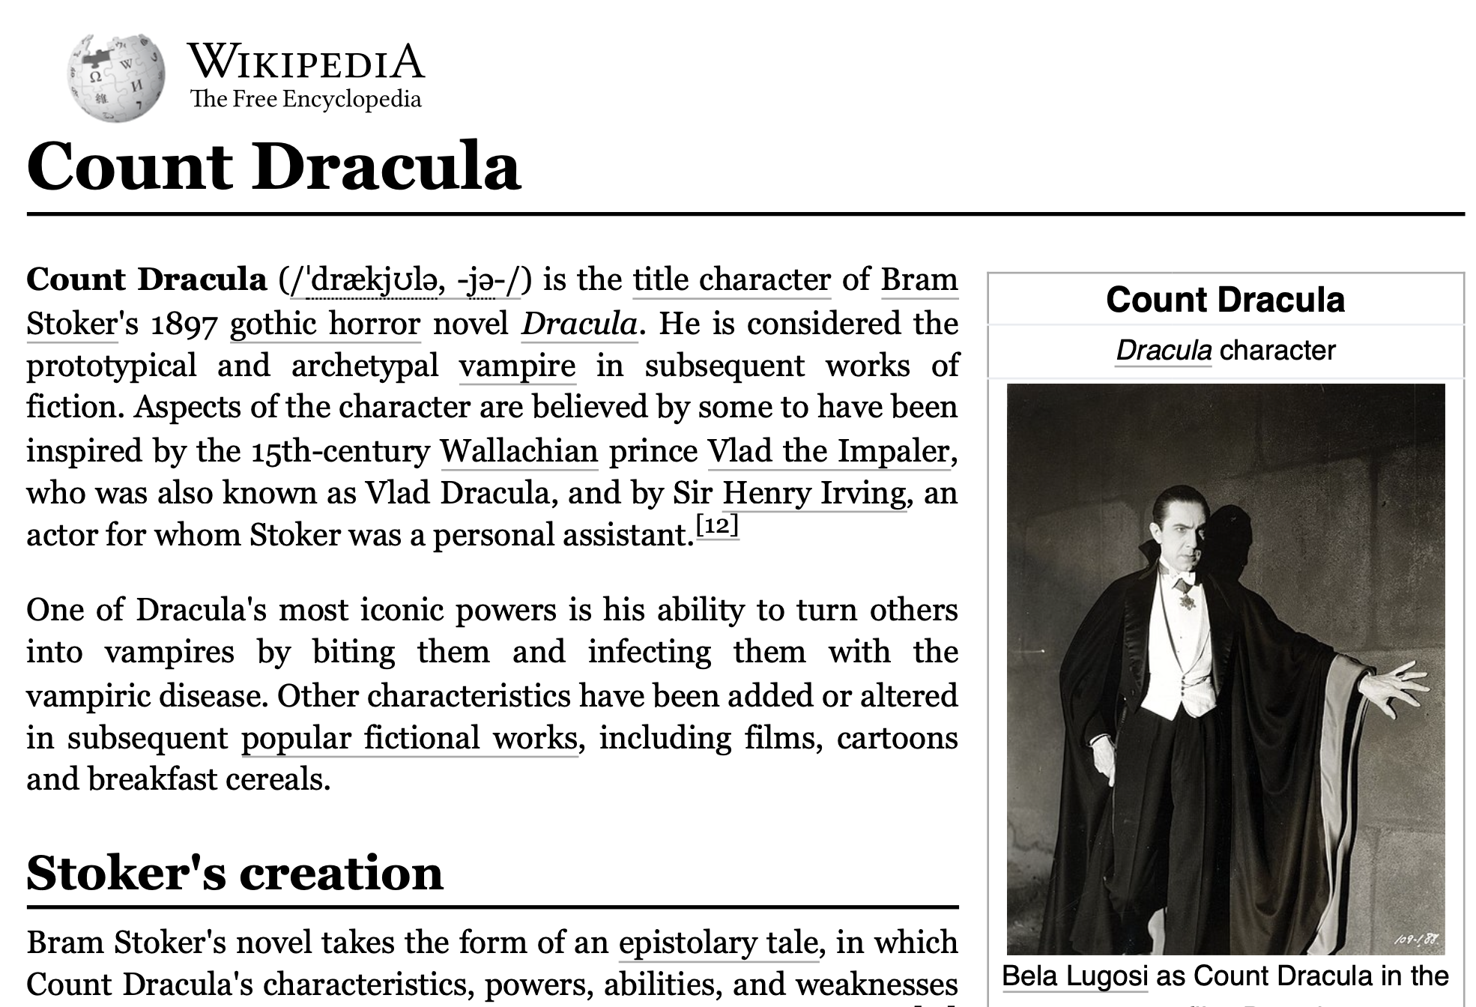

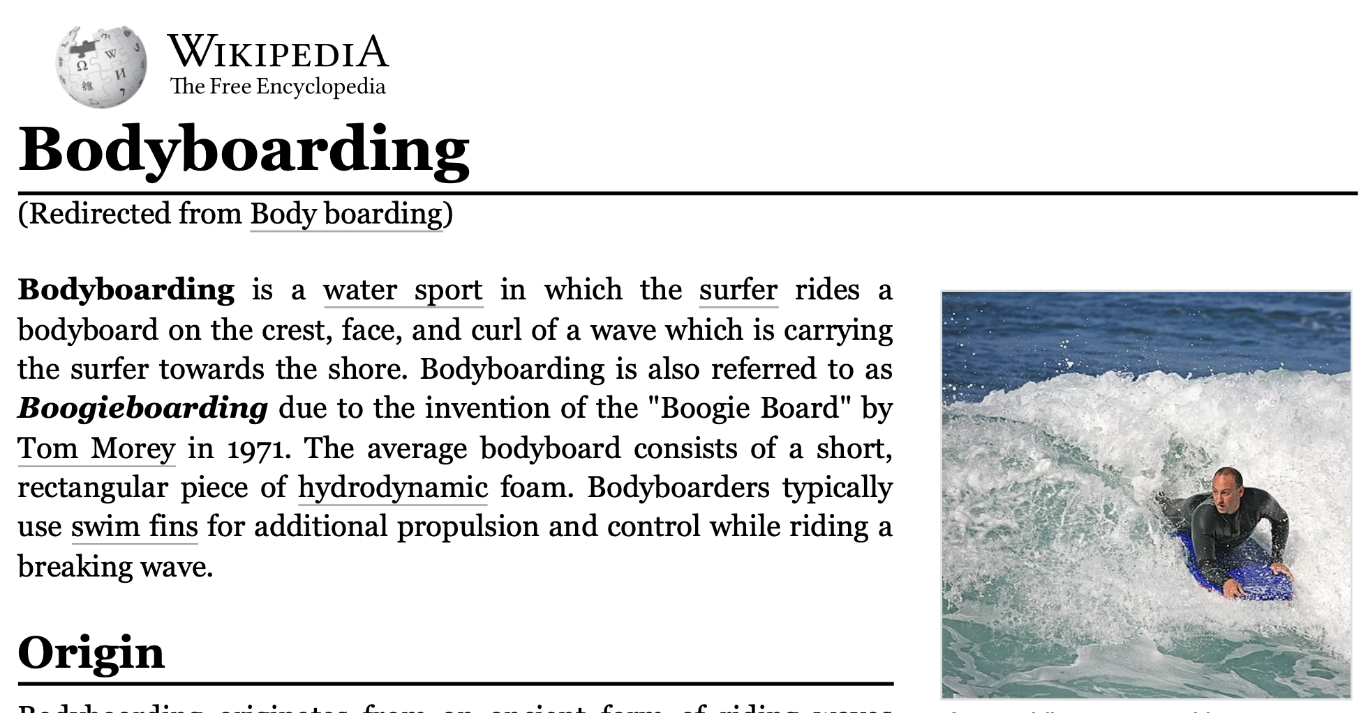
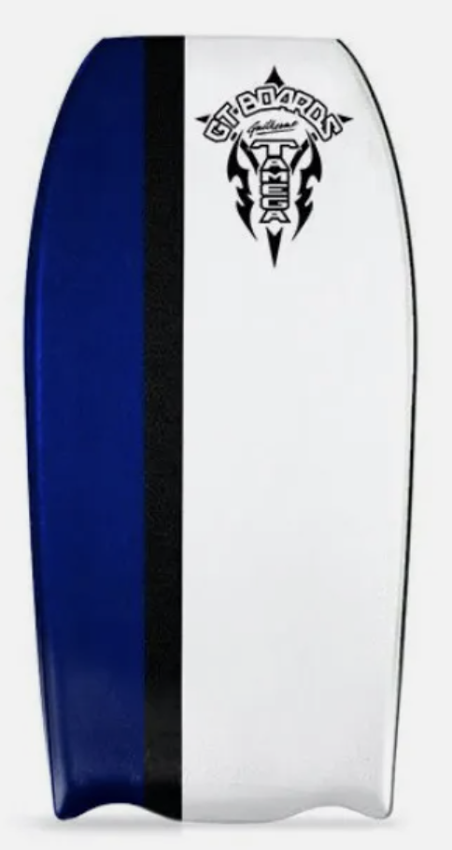
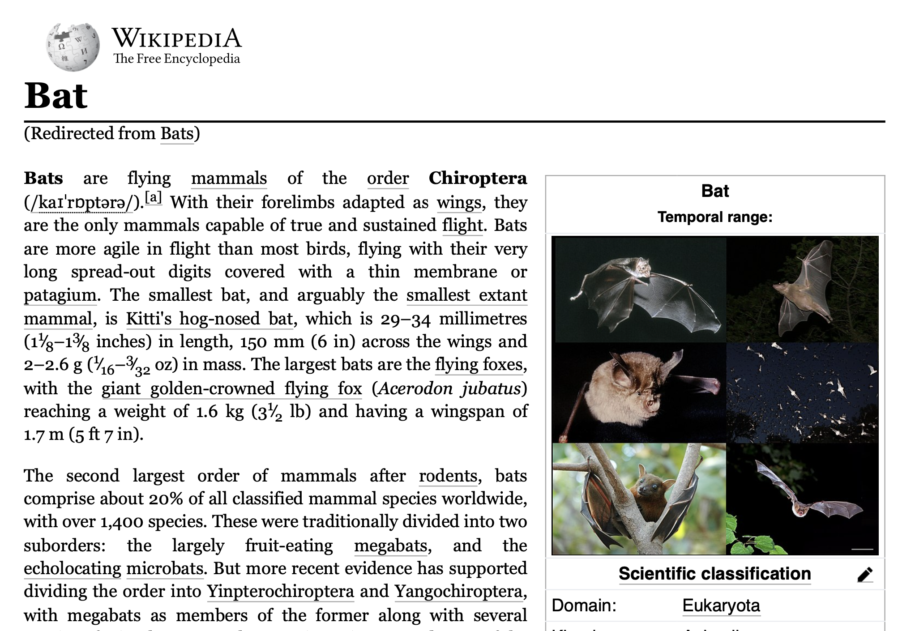

RAFT: Inference
What kind of vision do most microbats have?
query
Vampire
top-k retrieved documents
Mesopic vision
Bat tail
The RAFT-trained LLM synthesizes the answer from relevant documents
Microbat
Notes:
Similar to RAG
Retrieves oracle and distractor documents
Knows to pay attention to oracle documents
Straight to the point

Slide 12
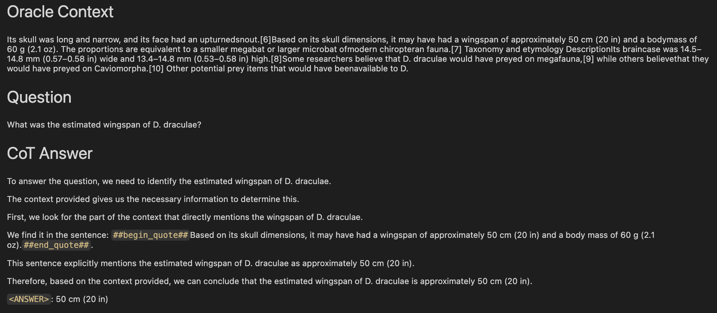
RAFT: Chain-of-thought ++

Slide 13
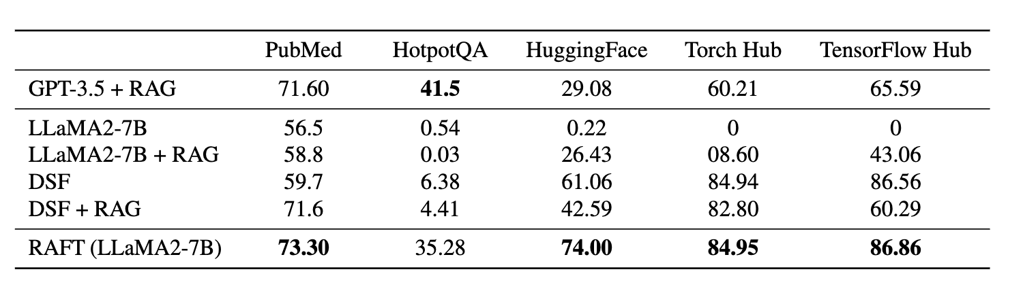
RAFT improves RAG performance for all specialized domains

Slide 14







RAFT Dataset generation
Fine-tuning dataset
CoT
LLM
Training
CoT
Chunking
LLM
CoT
Valid
CoT
Eval
Documents
Chunks
Questions
CoT
Answers
Oracle and
distractor chunks
Notes:
Cedric: Will use this slide while raft.py is running (roughly a minute) to explain what’s going on

Slide 15
Metrics
Base
Llama 2 7B Chat
Fine-tuned
Llama 2 7B
Similarity
To Llama 3 70B
2.73
4.76 (1.7x)
Groundedness
2.74
3.16 (1.15x)
Scores on a scale of 1-5
Notes:
Librarian

Slide 16
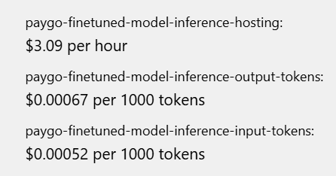
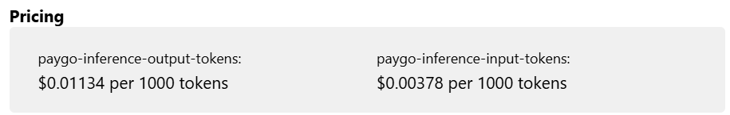
Inferencing Costs
Llama 2 7B Fine Tuned
tokens
Llama 3 70B
100x Cheaper for inference costs

Slide 17
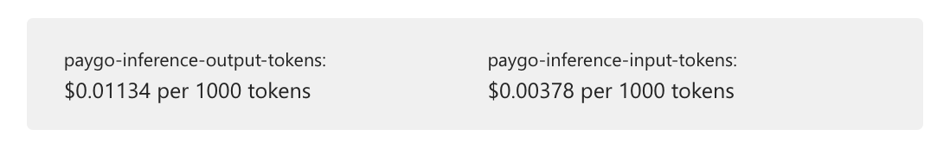
Fine tuning
Cost
Dataset generation
Model: Llama 3 70B
Data points 18K
Tokens_in 10M
Tokens_out 3.7M
Duration 1.5 hours
Cost $35/hour
Total ~ $80
Total ~ $50

Slide 18
Key Insights
Notes:
Cost
Load balancing
TPS throughput
TPM limits
Fine tuning completion vs chat model
0.00002 to fine tune a chat model, 1/00 of the base model’s learning rate
0.0002 to fine tune a completion model, 1/10 of the base model’s learning rate

Slide 19
Which fine-tuning learning rate?
We fine-tuned a Llama 2 7B completion model
LR 0.0002
LR 0.00002
Dataset 5k
Completion
base model
Instruct model
Fine-tuned
model
LR 0.0002
Dataset 20k
LR 0.00002
Notes:
Lower learning rate risks overwriting pre-trained knowledge

Slide 20
Shard
Throughput and Load balancing – Data gen
MaaS
MaaP
Convenient
Pay as You Go
No infra to manage
70 tokens / s
Standard_NC96ads_A100_v4
4x Nvidia A100
140 tok/s/VM in average
(35 tok/s/GPU x 4)
Requires managing provisioning and teardown
Shard the dataset across multiple load balanced endpoints
Increase tok/s
LiteLLM https://www.litellm.ai/
Load balancing on:
2 MaaP NC96ads_A100_v4 + 1 MaaS endpoint
=> 350 tok/s in average

Slide 21
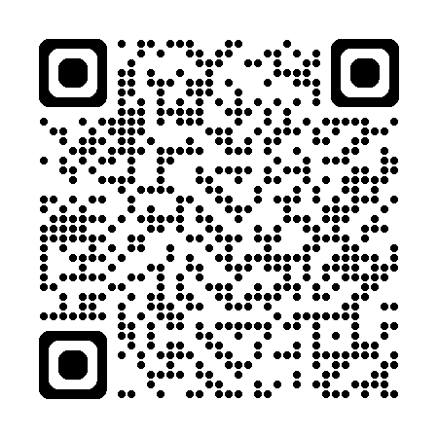
Thank you!
Cedric Vidal
Principal AI Advocate
Microsoft
aka.ms/cvidal
aka.ms/raft-recipe

